Slide 1
How members vs. casuals ride differently
Data covering the period from September 2024 through August 2025
Presented by: Dmytro Malymon

Slide 2
What are we talking about?

Slide 3
Objective
What sets annual members apart from casual riders in their usage of Cyclistic bikes? Investigate whether elements like bike model, time of day, seasonal trends, or other factors affect casual riders' decisions to use Cyclistic bikes.

Slide 4
Framing & methodology

Slide 5
Framing & methodology
Timeframe: September 2024 – August 2025 (trips starting before 2024-09-01 excluded).
Tools: all analysis was done in SQL on a cleaned dataset, then exported to Excel/Tableau for visualization.
Key cleaning rules:
  Removed trips < 60 seconds and negative durations.
  Retained legitimate long-duration rides.
  Added key derived fields (ride_length_min, weekday/weekend, daypart, month, bike type, etc.).Focus: comparison of members vs casuals.
Focus: comparison of members vs casuals.

Slide 6
Present data

Slide 7
Monthly trends
Notes:
Overview
The chart compares the number of rides per month for Cyclistic members and casual riders from January to December.
Each line represents a different rider group:
Blue: casual riders
Cyan (teal): annual members
🗓 1. Seasonal Trends
Both groups ride more in spring and summer, peaking in July–August.
Sharp decline in autumn and winter, showing strong seasonal dependence.
Weather and daylight likely major factors.

Slide 8
Monthly trends
Members always ride more than casuals in every month.
Notes:
👥 2. Member Behavior
Members maintain steady usage year-round.
Even in colder months, member rides stay relatively high.
Indicates more commuting or habitual trips — not just recreation.

Slide 9
Monthly trends
Members always ride more than casuals in every month.
Largest gap appears in September–October — members stay active longer.
Notes:
🚲 3. Casual Rider Behavior
Casual rides spike during summer and drop sharply in off-season.
Suggests recreational or tourist use patterns.
Casuals are more weather-sensitive and short-term users.

Slide 10
Monthly trends
Members always ride more than casuals in every month.
Largest gap appears in September–October — members stay active longer.
Strong opportunity to convert casuals to members through seasonal promotions.

Slide 11
Weekday vs weekend
Notes:
Overview
The chart compares Cyclistic ridership between members and casual users on weekdays and weekends.
Each line represents a different rider group:
Blue: casual riders
Cyan (teal): annual members
1. Weekday Activity
Members ride much more on weekdays — nearly double the casual riders.
Suggests members use bikes mainly for commuting and daily travel.
Indicates strong integration into regular routines.
2. Weekend Activity
Casual riders’ share rises on weekends, nearly matching members.
Points to more leisure and recreational riding among casual users.
Members ride slightly less, reflecting workweek usage patterns.

Slide 12
Weekday vs weekend
Clear behavioral difference:
Members = commuters (weekday focus).
Casuals = recreational riders (weekend focus).
Opportunity: promote weekend offers to convert casuals into regular members.

Slide 13
Daypart
Notes:
The chart compares Cyclistic ride volume by time of day for members and casual riders.
Both groups ride most often during the afternoon, but members show clear commuting peaks in the morning and evening, while casual riders are more active during midday — indicating leisure use
1. Morning & Evening
Members show strong peaks in the morning (commute to work) and evening (return home).
This pattern is consistent with weekday commuting behavior.
2. Midday
Casual riders dominate midday rides, especially around lunchtime and early afternoon.
Suggests tourism, recreation, or flexible leisure activity.
3. Night
Both groups have fewer rides at night, but casual users still show some late activity — likely social or leisure rides.
.

Slide 14
Daypart
Members = structured, commuter-style riding (rush hours)
Casuals = flexible, leisure-oriented riding (midday focus)
Insights can help tailor targeted campaigns — e.g., encourage casuals to use bikes for weekday commutes.
Notes:
The chart compares Cyclistic ride volume by time of day for members and casual riders.
Both groups ride most often during the afternoon, but members show clear commuting peaks in the morning and evening, while casual riders are more active during midday — indicating leisure use
1. Morning & Evening
Members show strong peaks in the morning (commute to work) and evening (return home).
This pattern is consistent with weekday commuting behavior.
2. Midday
Casual riders dominate midday rides, especially around lunchtime and early afternoon.
Suggests tourism, recreation, or flexible leisure activity.
3. Night
Both groups have fewer rides at night, but casual users still show some late activity — likely social or leisure rides.
.

Slide 15
Bike type
Notes:
This stacked bar chart compares the bike type preferences of Cyclistic members and casual riders.
Both groups use a mix of classic and electric bikes, but casual riders use slightly more electric bikes, while members favor classic bikes for their regular commutes.
Scooter usage remains very low across both groups.
1. Classic Bikes
Most common bike type for both groups.
Members use classic bikes slightly more often, reflecting routine commuting and cost-conscious behavior.
2. Electric Bikes
Casual riders rely more on electric bikes, likely for comfort and convenience on longer or leisure rides.
Electric bikes make up a larger percentage of casual rides than member rides.
3. Electric Scooters
Minimal share for both members and casuals.
May be limited by availability or user familiarity.

Slide 16
Bike type
Members = classic bike preference (commuting, routine use)
Casuals = higher electric bike use (leisure, exploration)
Marketing opportunity: highlight electric bike comfort to attract casuals, and membership savings for frequent riders.

Slide 17
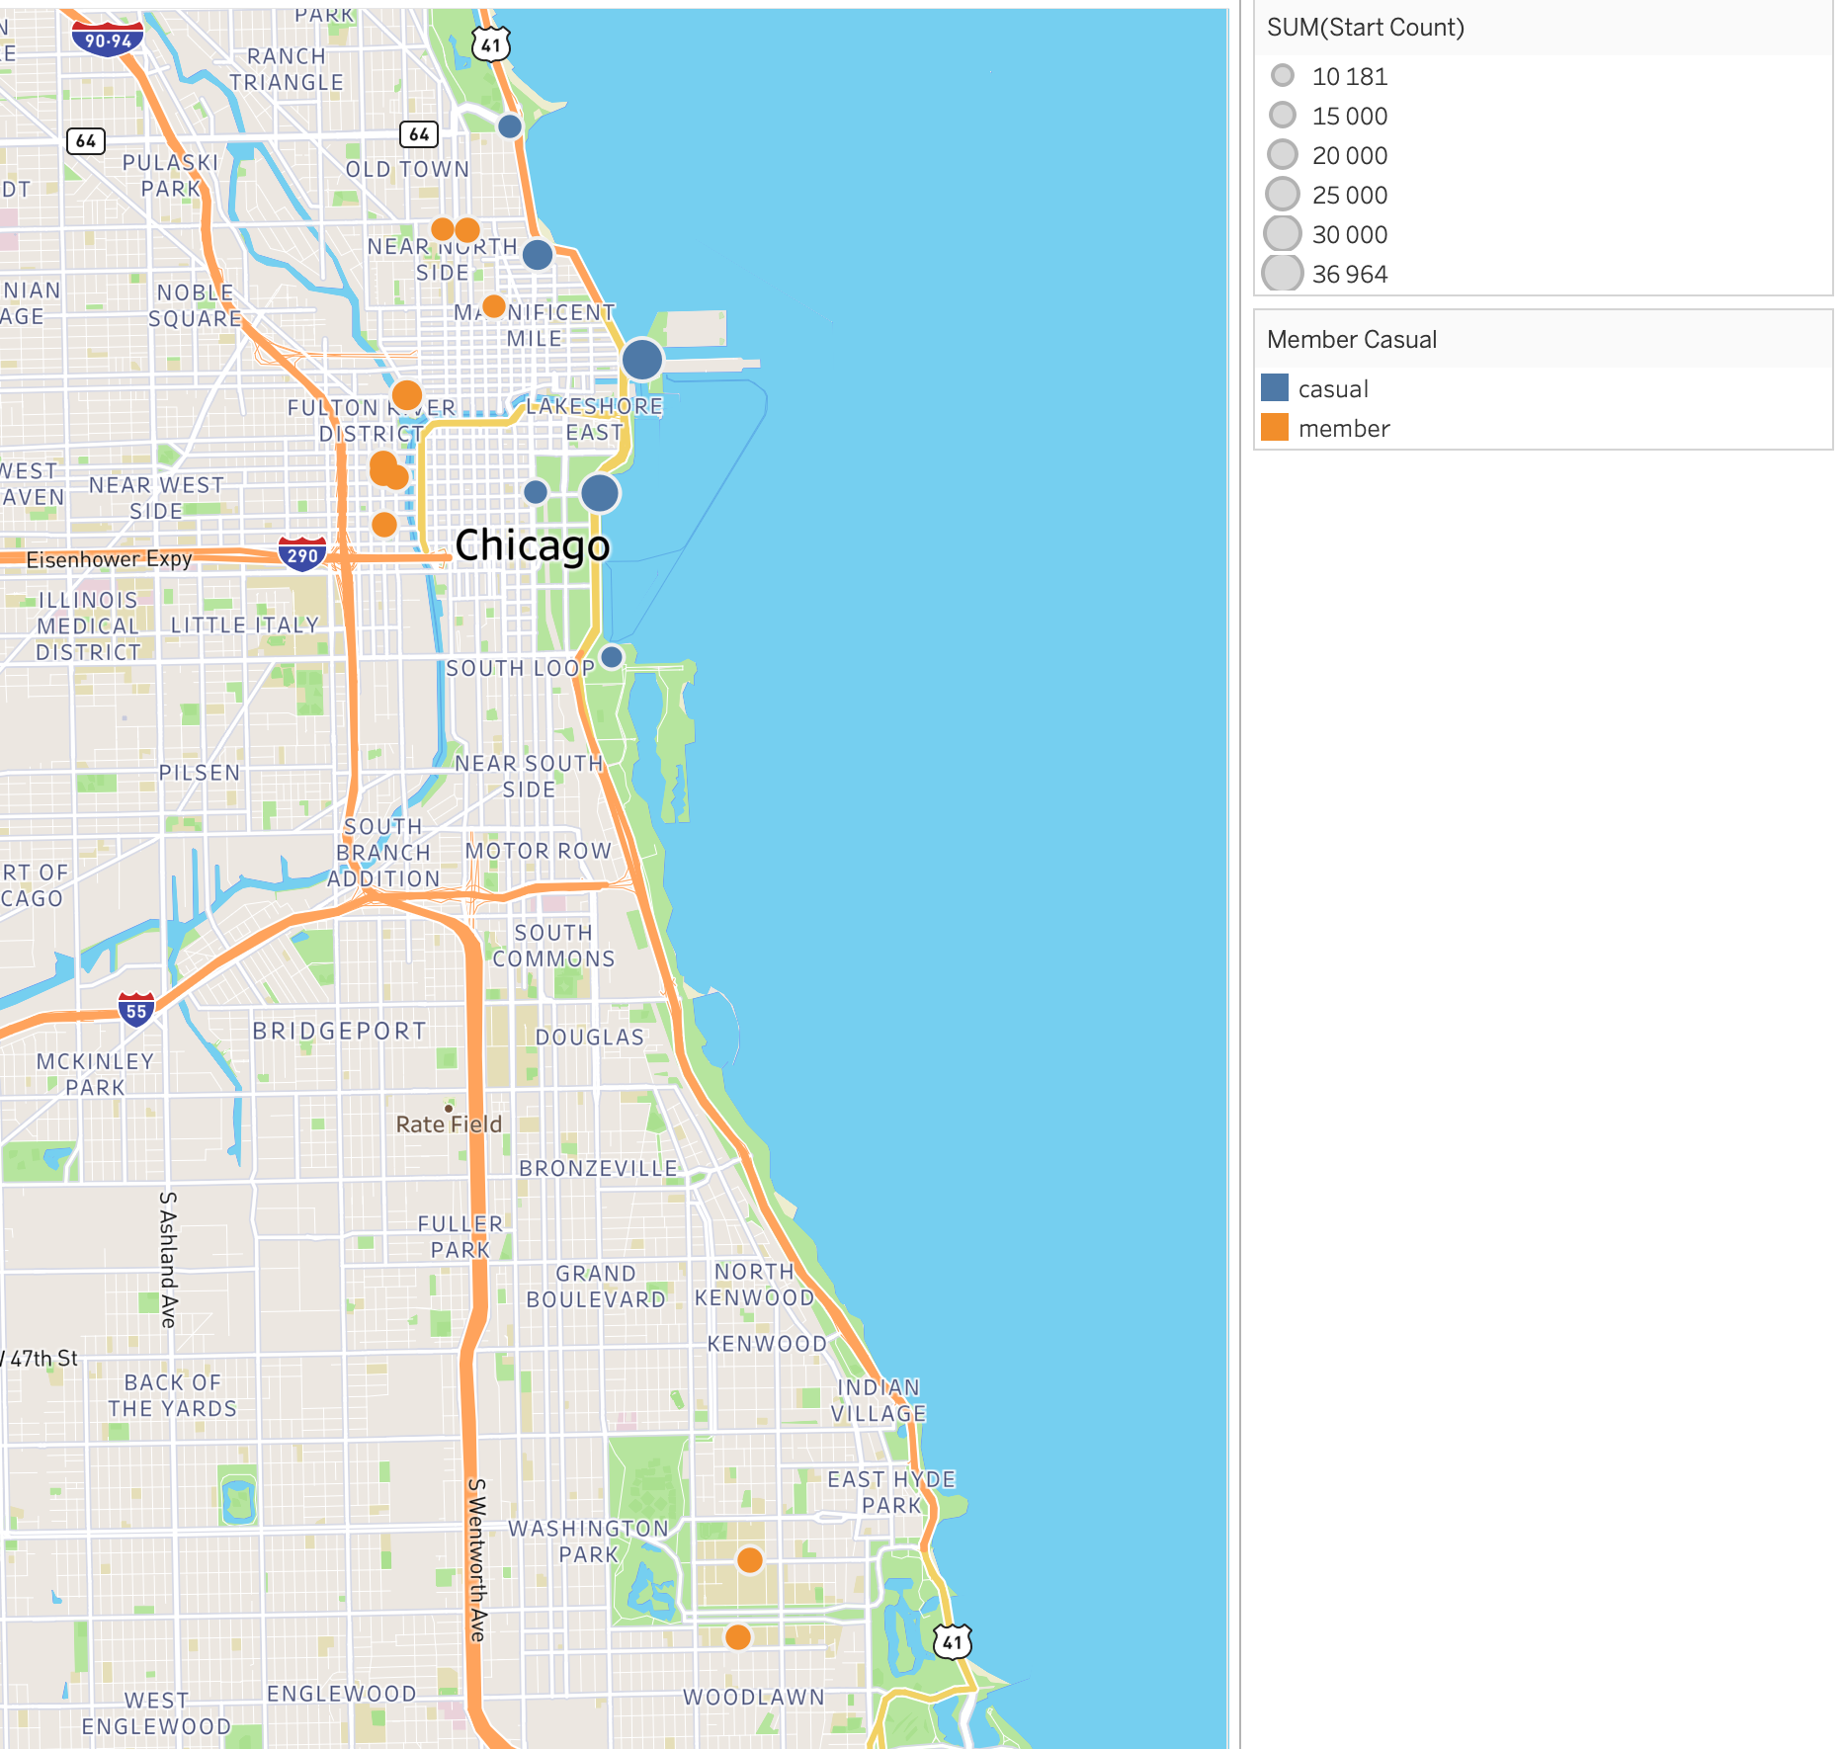
Top start stations (per rider type)
Notes:
Overview
This map shows the top start stations for Cyclistic members and casual riders, with circle size representing trip volume and color indicating rider type. The patterns reveal that casual riders and members rely on different key stations, reflecting distinct use cases.
Different hotspots
Casual riders cluster around tourist and leisure locations along the lakefront (e.g., Navy Pier, museum & park areas).
Members concentrate near transport hubs and dense residential/business areas in central Chicago.
Behavior signal
Casual riders use bikes mainly for exploring attractions and the waterfront.
Members use bikes for everyday commuting and local mobility.

Slide 18
Top start stations (per rider type)
Casual riders use bikes mainly for exploring attractions and the waterfront.
Members use bikes for everyday commuting and local mobility.
Notes:
Overview
This map shows the top start stations for Cyclistic members and casual riders, with circle size representing trip volume and color indicating rider type. The patterns reveal that casual riders and members rely on different key stations, reflecting distinct use cases.
Different hotspots
Casual riders cluster around tourist and leisure locations along the lakefront (e.g., Navy Pier, museum & park areas).
Members concentrate near transport hubs and dense residential/business areas in central Chicago.
Behavior signal
Casual riders use bikes mainly for exploring attractions and the waterfront.
Members use bikes for everyday commuting and local mobility.

Slide 19
Conclusions

Slide 20
Concusions
Members ride more often, all year, and mainly on weekdays and commute hours. Casual riders are highly seasonal, focused on weekends, midday, and good weather.
Member behavior looks like everyday transport (shorter, consistent rides from commuter hubs). Casual behavior looks like leisure/tourism (longer rides, tourist areas, e-bikes, lakefront stations).
Use insights on when, where, and how casuals ride to position membership as the cheaper, more convenient option for the patterns they already have.

Slide 21
Thank you

